Slide 1
Review Based Analysis of Mobile Phones
Group Members: Supervisor:
Muhammad Suleman Mr. Zeshan Khan
Asjid Ahmed

Slide 2
Overview
Introduction
Objective
Methodology
Limitations
Results
FYP-II Progress
FYP-II Milestones

Slide 3
Introduction
A web application that will take different features of mobile phones as input and display the top mobile phone suggestions after analyzing the user reviews.

Slide 4
Objective
To develop a platform for selection of mobile phones. In order to achieve primary objectives:
Polarity of reviews
Specific features selection
Analysis of the specific features of the mobile phone reviews

Slide 5
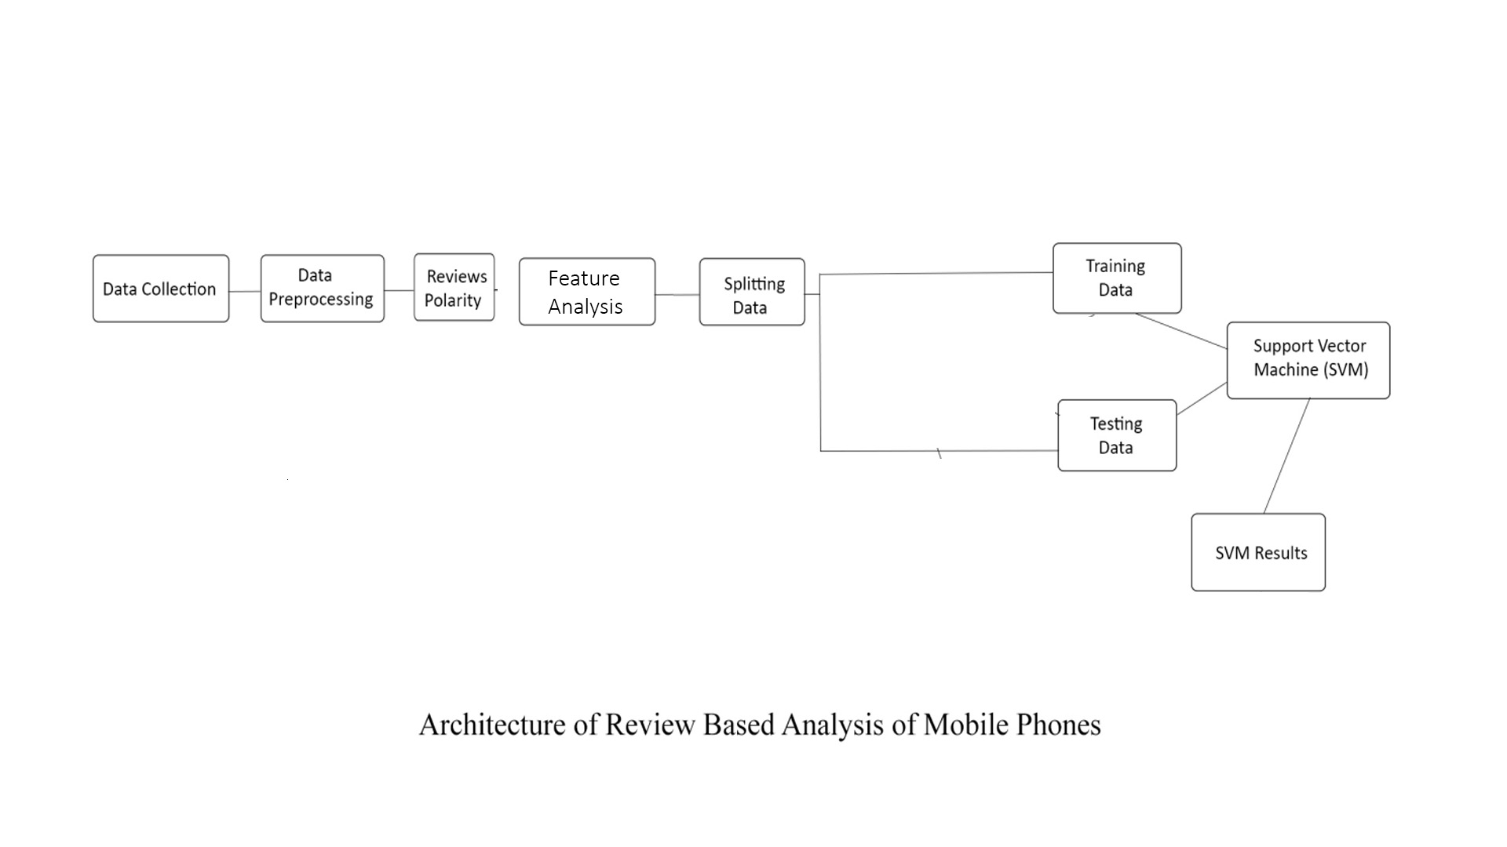
Methodology

Slide 6
Limitations
Works only on selective features.
Computationally expensive
Accuracy may vary according to data-set

Slide 7
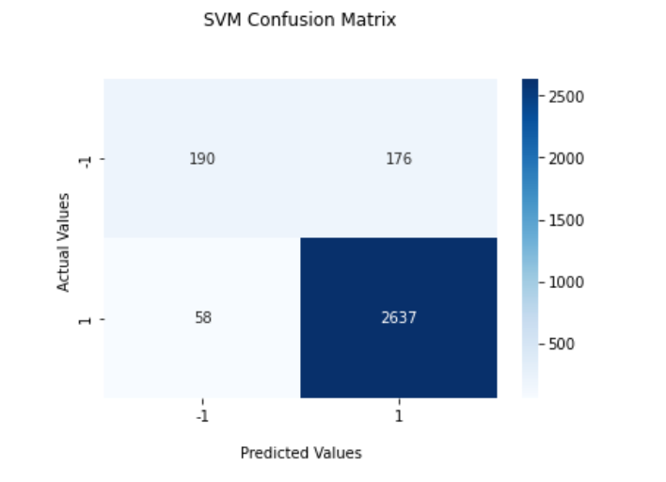
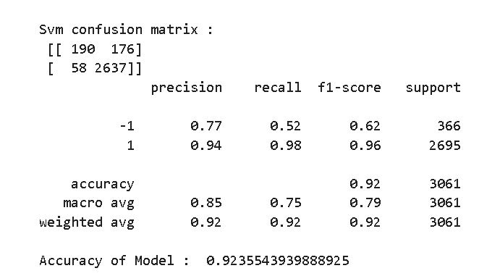
Results

Slide 8
FYP-II Progress
Sentence Level Analysis of reviews
Features Level Analysis of reviews
Results Calculations
Evaluation Measure

Slide 9
FYP-II Milestones
Web Application

